Slide 1

UNIT 1 · PART 2
Agent–Environment Interaction Model
PEAS Framework · Perception–Reasoning–Action Cycle · Intelligent Agents

Slide 2

FOUNDATION
From Human Thinking to AI Thinking
Both humans and AI follow a similar decision loop — observe, process, decide, act.
🧠 Human Decision Making
🤖 AI Decision Making
Eyes observe surroundings
Brain understands the situation
Logical reasoning applied
Decision made
Action performed
Sensors detect the environment
AI model processes information
Reasoning engine analyzes data
Best action selected
Actuators execute
Example: Red traffic light → Camera detects → AI decides "Stop" → Brakes applied

Slide 3
CORE CONCEPT
What is an Agent?
An Agent is any entity that perceives its environment, processes information, takes actions, and works toward achieving goals.
Mathematical Form
Human
ChatGPT
Agent = f(Percepts) → Actions
Every action is a function of what the agent has perceived.
Environment: Physical World
Environment: User Prompt
Robot
Alexa
Environment: Factory Floor
Environment: Voice Commands

Slide 4
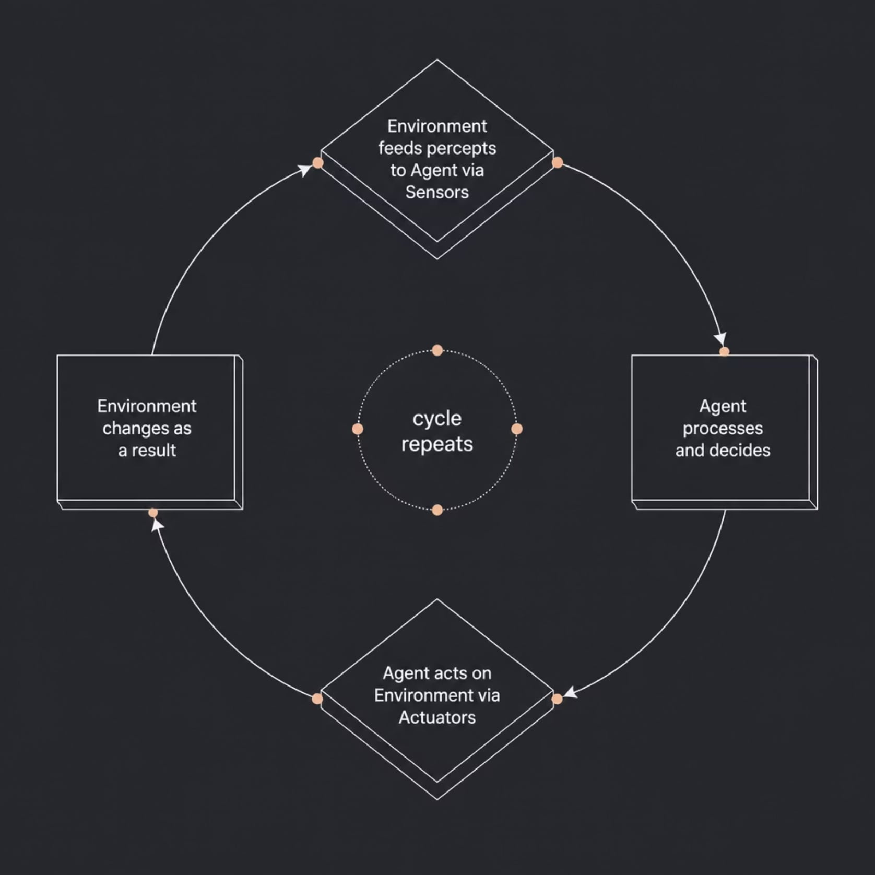

CORE CONCEPT
What is an Environment?
The Environment is everything surrounding an agent with which it interacts. Without an environment, there is no agent — the two are inseparable.
Robot
Self-Driving Car
ChatGPT
Drone
→ Factory Floor
→ Road Network
→ User Prompts
→ Sky / Airspace

Slide 5

ARCHITECTURE
Agent–Environment Interaction Model
The core architecture of every intelligent agent — a continuous loop of sensing, thinking, and acting.
Environment
Sensors
Perception
Reasoning
The agent never acts in isolation — every action changes the environment, which generates new percepts, restarting the cycle.
Example — Smart Door Lock: Environment (door) → Fingerprint Sensor → AI verifies identity → Decision (unlock) → Actuator (motor) → Environment changes (door opens)

Slide 6





COMPONENTS
Components of an Intelligent Agent
Environment
Everything surrounding the agent — roads, rooms, networks, user inputs.
Sensors
Collect raw data: Camera, Microphone, GPS, LiDAR, Radar, Temperature Sensor.
Perception & Reasoning
Understand data and analyze it using rules, ML, or LLMs.
Actuators
Execute output actions: Motor, Speaker, Display, Robot Arm, Steering.

Slide 7
KEY DISTINCTION
Sensors vs. Actuators
📡 Sensors — Receive Input
⚙️ Actuators — Perform Output
Sensors are the agent's input channels — they collect raw data from the environment.
Actuators are the agent's output channels — they act on the environment.
Camera → visual data
Microphone → audio data
GPS → location data
LiDAR / Radar → distance data
Temperature Sensor → thermal data
Motor → movement
Steering → direction control
Brake → stopping
Speaker → audio output
Display → visual feedback

Slide 8








THE CORE LOOP
Perception → Reasoning → Action Cycle
This repeating cycle is the heartbeat of every intelligent agent. It never stops while the agent is active.
Perception
Reasoning
Collect and interpret raw sensor data into meaningful information.
Analyze information using rules, ML, or LLMs to evaluate options.
Action
Decision
Execute via actuators, changing the environment and restarting the cycle.
Select the best action based on goals, constraints, and utility.

Slide 9
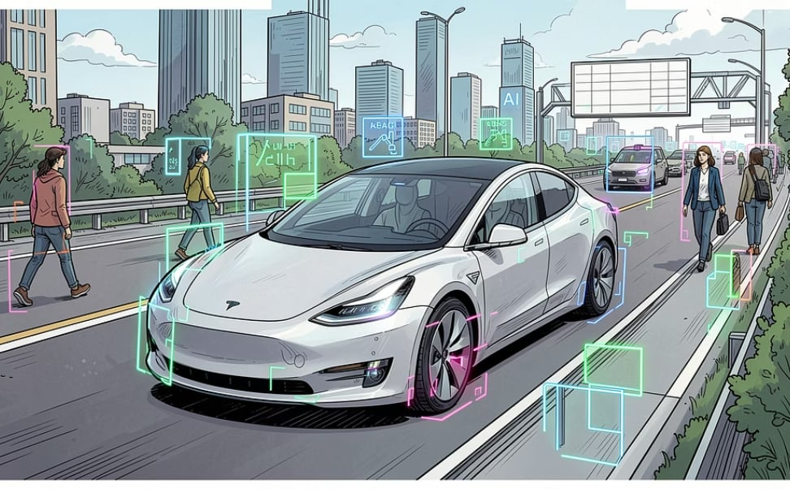

REAL-WORLD APPLICATIONS
Agents in Action
🚗 Self-Driving Car
🏠 Smart Home (Alexa / Thermostat)
Perception: Camera detects road & pedestrians
Reasoning: AI predicts collision risk
Decision: Apply brakes immediately
Action: Car stops safely
Perception: Temperature sensor reads room heat
Reasoning: AI compares to target comfort level
Decision: Turn ON the AC
Action: Room reaches comfortable temperature

Slide 10
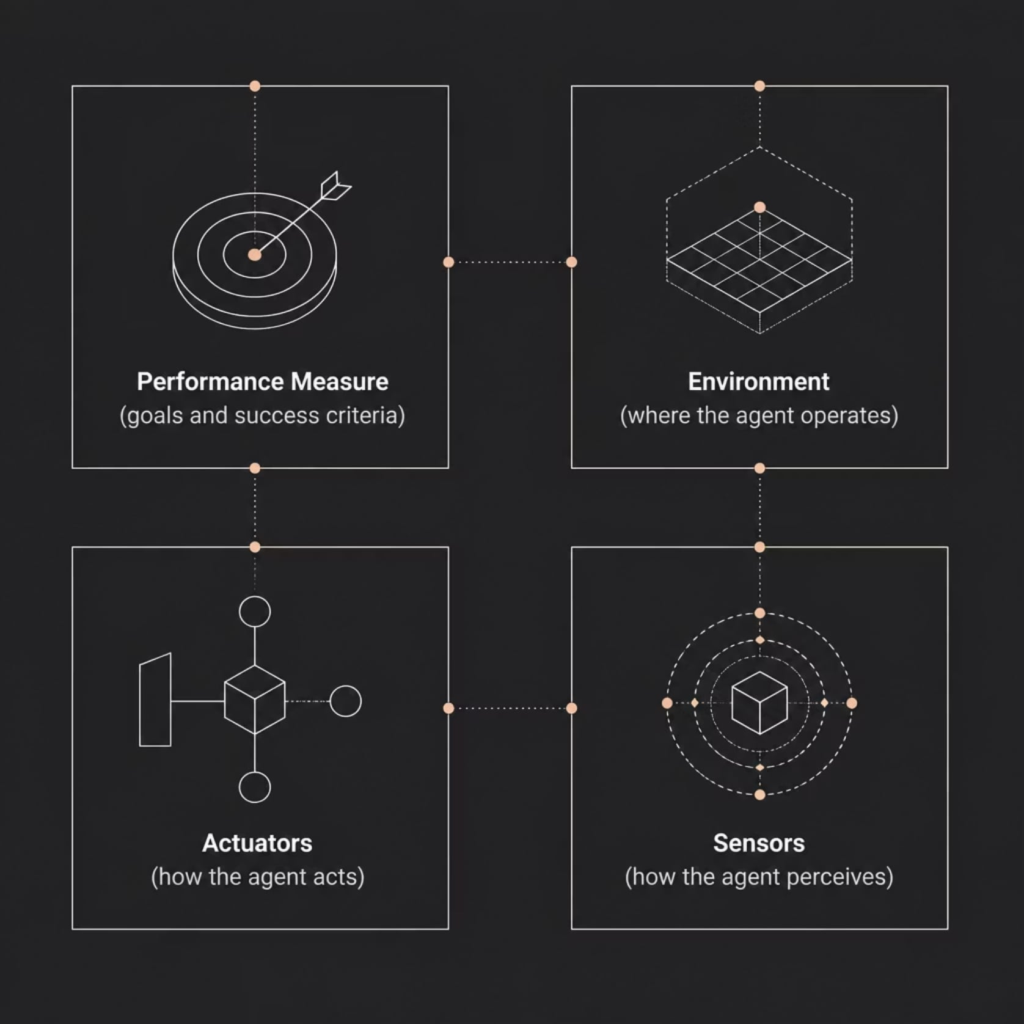


DESIGN FRAMEWORK
The PEAS Framework
PEAS is the standard framework for designing and specifying intelligent agents before building them.
P — Performance Measure
E — Environment
What defines success? e.g., Safe driving, maximum cleaning
Where does it operate? e.g., Roads, House
A — Actuators
S — Sensors
How does it act? e.g., Brake, Motor
How does it perceive? e.g., Camera, GPS, LiDAR
Up Next — Part 3: Environment Types (Observable, Deterministic, Static…) · Agent Classifications (Reflex, Model-Based, Goal-Based, Utility-Based) · Architecture diagrams & exam prep

